Slide 1
Huffman Coding
Neil Patel

Slide 2
Problem:
Files/Messages can be compressed down
An ASCII encoding of “ABBABCDDDCBBABBD” would be 128 bits
Each ASCII character is 8 bits, 8 x 16 characters = 128
Because every single ASCII character isn’t being used in this message, it can be compressed using Huffman Coding

Slide 3
Variable Length Encoding:
Huffman Coding uses variable length encoding
The code assigned to a character depends on how frequently the character appears in the message
A frequently occurring character would receive a shorter code
A rare character receives a longer code

Slide 4
Huffman Coding - Basic Overview:
“ABBABCDDDCBBABBD”
First, sort each character in increasing order (by frequency)
C
A
D
B
2
3
4
7

Slide 5
Huffman Coding - Basic Overview:
Create a Huffman Tree
Merge the two least occurring characters into a node
This node represents the sum of their frequencies
Repeat until every character has merged into the tree
5
C
A
2
3

Slide 6
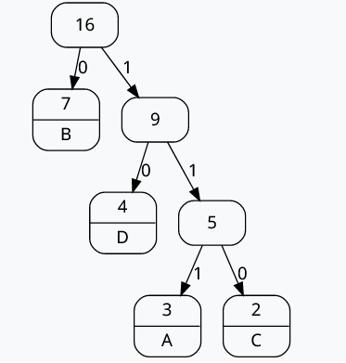
Huffman Coding - Basic Overview:
Now, give the edges a binary digit
This tree represents each character in the message
Notice that, frequent chars are given shorter codes (ex: B is given just ‘0’), non-frequent chars are given longer codes (ex: C is given ‘110’)

Slide 7
Huffman Coding - Comparison:
“ABBABCDDDCBBABBD”
Using ASCII encoding, 128 bits
Each character in message represented by 8 bits
Using Huffman coding, 30 bits
B = 1 bit, D = 2 bit, A = 3 bit, C = 3 bit
7(1) + 4(2) + 3(3) + 2(3) = 30 bits

Slide 8
Huffman Coding - Decoding:
When a message has been encoded, to read the message, you need to decode it
For Huffman Coding, to decode, just follow the Huffman Tree
“BACC” = “0 111 110 110”
“0 111 110 110” = “BACC”

